Slide 1
Heart Disease Classification Through Machine Learning Techniques
DS 320 Term Project
By Sarah Petro and Jane Schneider

Slide 2

Introduction & Background
Heart disease is one of the leading causes of death in the United States
Machine learning techniques to accurately diagnose disease and symptoms
Complicated disease and
symptoms
Data integration of
3 heart disease datasets
Tested 4 different ML models
Notes:
3 cities for Heart Disease Dataset: Cleveland, Hungarian, and Switzerland
The heart disease datasets are from leading data collectors and researchers on the topic named UCI Cleveland
300 observations after dropping NA

Slide 3
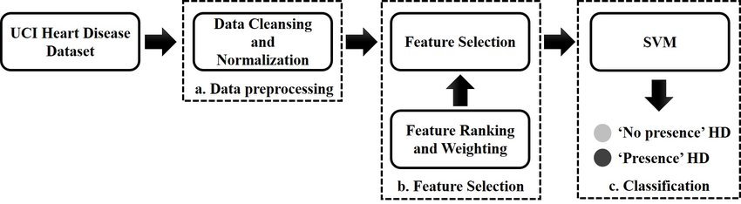
Challenges & Related Work
Feature selection is the most difficult challenge
“Classification models for heart disease prediction using feature selection and PCA” by Anna Karen Gárate-Escamila et al. in 2020
“Heart Disease Classification Using Neural Network and Feature Selection” by A. Khemphila and V. Boonjing in 2011
Notes:
98% to 99% accuracy for first paper using PCA and used a combination of six models: decision tree, gradient-boosted tree, logistic regression, multilayer perceptron, Naïve Bayes, and random forests
Used Artificial Neural Networks with 82% accuracy
Shows well-researched topic; important to medical community
Complicated disease, hard to diagnose

Slide 4
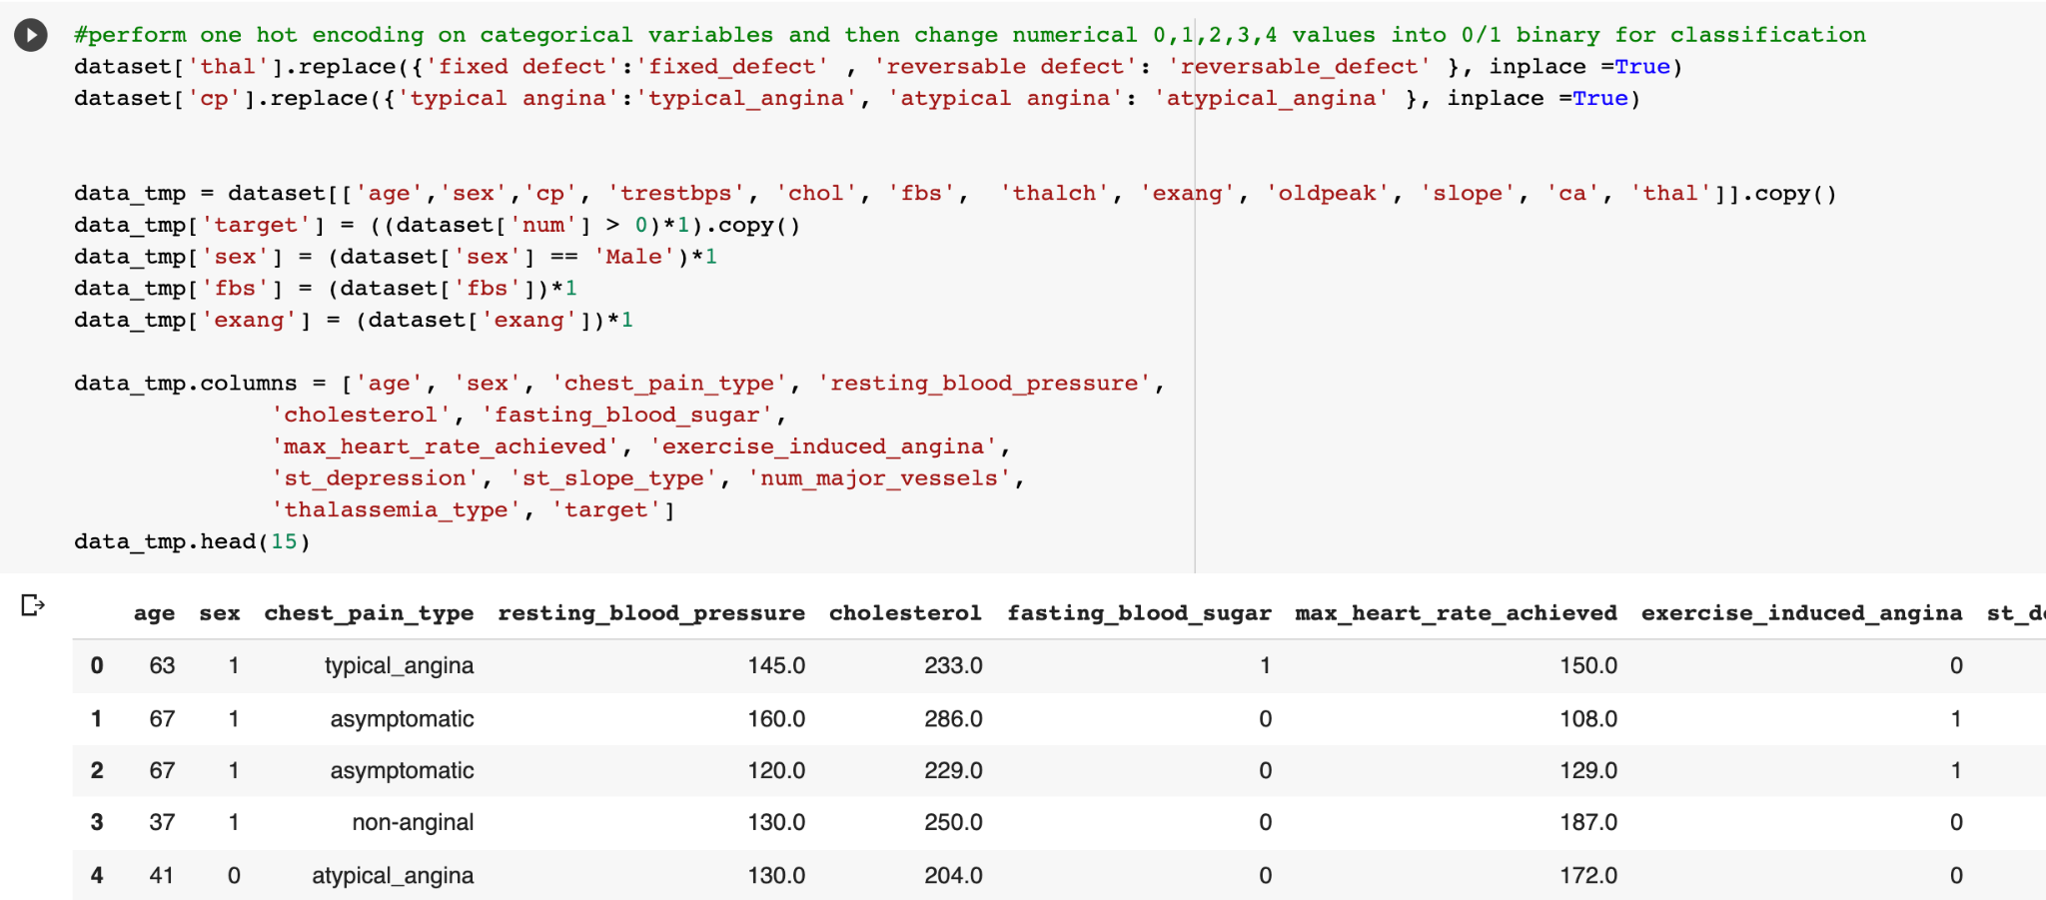
Data Preprocessing and Integration
Integrated 3 datasets to make one larger dataset
Hungary, Switzerland, and Cleveland
300 observations
Dropped NA values
Performed one hot encoding on categorical variables for classification
Notes:
One hot encoding: creates a binary column for each category and returns a sparse matrix or dense array
For categorical variables where no such ordinal relationship exists
This is where the integer encoded variable is removed and a new binary variable is added for each unique integer value.

Slide 5
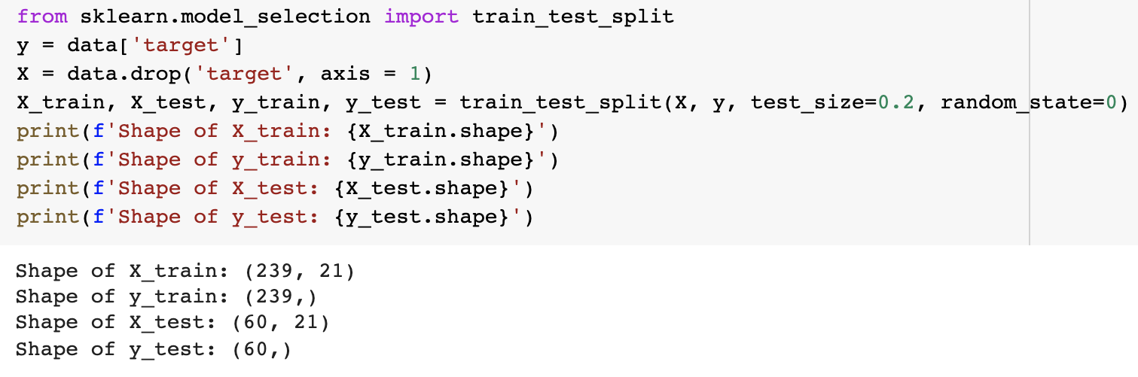
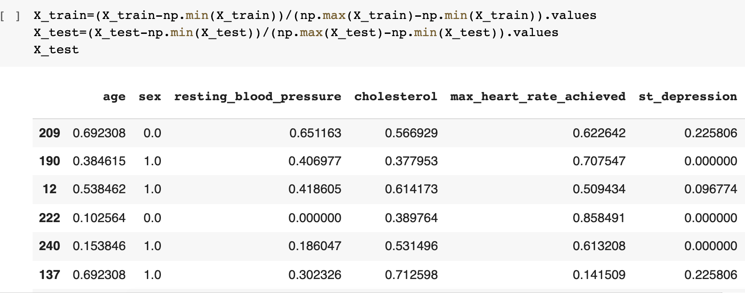
Test-Train Split
Implemented test-train split to separate original data for performance evaluation
X_train, y_train, X_test, y_test
Min-Max normalization of X_train and X_test
Steps:
Train the model with X_train and y_train
Use model to predict y_predict from X_test
Compare y_predict against y_test for evaluation

Slide 6
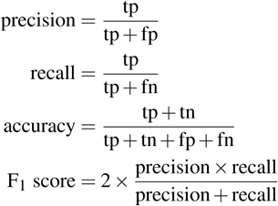
Model Building
Paid close attention to performance metrics: accuracy, F1-score, precision, and recall
4 Models with tuning of hyperparameters::
Logistic Regression
Decision Tree (Balanced and Unbalanced)
Gradient Boosting (ensemble technique)
Random Forest (Balanced and Unbalanced)

Slide 7
Models, Results, and Metrics
Logistic Regression:
Accuracy: 0.83
Similar performance to
other models
Gradient Boosting Classifier:
Accuracy: 0.83
Ensemble learning; best precision, recall, f1-score
Decision Tree:
Accuracy: 0.78 unweighted,
0.68 weighted
Performed worst out of all the
models
Random Forest:
Accuracy: 0.83
High precision
Notes:
F1-score measure of a model's accuracy on a dataset
LR: an obvious model to test because it uses regression analysis which finds the relationship between a dependent variable and one or more independent variables
DT: high performing classification models because it breaks down a dataset into smaller and smaller increments while subsequently building a decision tree that determines the best predictors. Decision trees are common classification models, especially in cases such as this with a large amount of important features to consider
GBC: this model uses ensemble learning which iteratively learns from each of the weak learners to build a strong model. Gradient boosting is a highly accurate model, especially for classification problems such as this one
RF: which fits a number of decision tree classifiers on samples of the training data and uses averaging to improve the optimal accuracy of the model

Slide 8
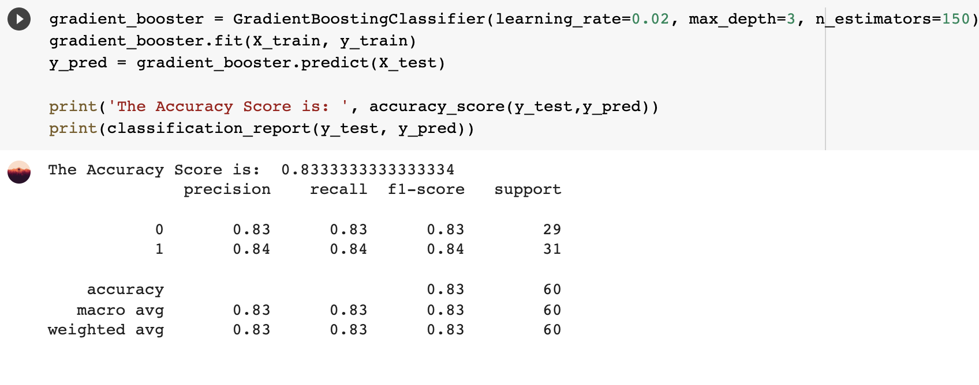
Best Model: Gradient Boosting Classifier
Highest f1-score; makes up for slightly lower accuracy
Best evaluation metric: F1 score
Best for data with unbalanced classes
Notes:
GBC: this model uses ensemble learning which iteratively learns from each of the weak learners to build a strong model. Gradient boosting is a highly accurate model, especially for classification problems such as this one

Slide 9
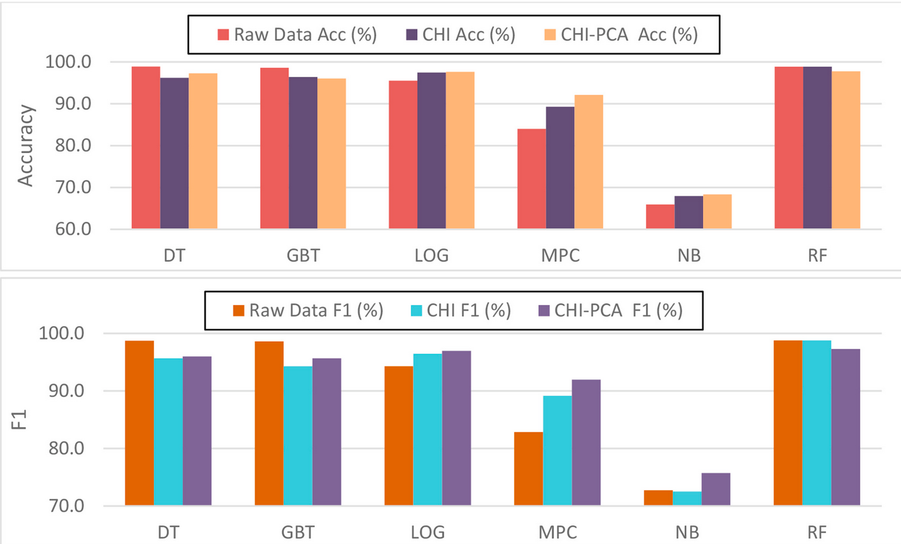

Conclusion
Heart disease classification is inherently difficult to study
Genetic and environmental factors difficult to quantify
Research is ongoing
researchers Anna Karen Garate-Escamila et al. have achieved 98%-99% accuracy
Data Science: the future of medical diagnosis
Great impact on medical research
Provide mathematical insights that would go unnoticed by human capabilities

Slide 10
Lessons Learned
Data Integration:
Combining 3 smaller datasets (Hungary, Switzerland, Cleveland) into one large dataset
Data Preprocessing:
Removing NA values
Encoding of categorical attributes
Min-max normalization for training classification models
Model Building, Tuning, and Evaluation:
Test-Train split to measure model performance
F1-score for evaluation of models with unbalanced training data

